Slide 1
Educational Workshop: Learning Situation
Here is where your presentation begins

Slide 2
Contents of this template
You can delete this slide when you’re done editing the presentation
Fonts | To view this template correctly in PowerPoint, download and install the fonts we used
Used and alternative resources | An assortment of graphic resources that are suitable for use in this presentation
Thanks slide | You must keep it so that proper credits for our design are given
Colors | All the colors used in this presentation
Icons and infographic resources | These can be used in the template, and their size and color can be edited
Editable presentation theme | You can edit the master slides easily. For more info, click here
For more info:
SLIDESGO | BLOG | FAQs
You can visit our sister projects:
FREEPIK | FLATICON | STORYSET | WEPIK | VIDEVO

Slide 3
Table of contents
01
04
02
03
Theory lesson
Practical exercise
You can describe the topic of the section here
You can describe the topic of the section here
Features of the topic
You can describe the topic of the section here
Tips
You can describe the topic of the section here

Slide 4
Introduction
Mercury is the closest planet to the Sun and the smallest one in the entire Solar System. This planet's name has nothing to do with the liquid metal, since Mercury was named after the Roman messenger god. Its temperatures aren't as terribly hot as that planet's
Mercury takes a little more than 58 days to complete its rotation, so try to imagine how long days must be there! Since the temperatures are so extreme, albeit not as extreme as in Venus, Mercury has been deemed to be non-habitable for humans

Slide 5
01
Theory lesson
You can enter a subtitle here if you need it

Slide 6
—Someone Famous
“This is a quote, words full of wisdom that someone important said and can make the reader get inspired.”

Slide 7
What is this topic about?
Mercury
Mercury is the closest planet to the Sun and the smallest of them all
Venus
Venus has a beautiful name and is the second planet from the Sun
Mars
Despite being red, Mars is actually a very cold place

Slide 8
Features of the topic
Mars
Venus
Mars is actually a extremely cold place
Venus has extremely high temperatures
Jupiter
Saturn
Jupiter is the biggest planet of them all
Saturn is a gas giant and has several rings

Slide 9
Some percentages
25%
50%
75%
Mercury
Venus
Mars
It’s the closest planet to the Sun
Venus has a very beautiful name
Mars is full of iron oxide dust

Slide 10
Examples
Do you know what helps you make your point crystal clear? Lists like this one:
They’re simple
You can organize your ideas clearly
You’ll never forget to buy milk!
And the most important thing: the audience won’t miss the point of your presentation

Slide 11
Recommendations
Mars
Venus
Neptune
Despite being red, it’s actually a cold place
Venus has extremely high temperatures
Neptune is the farthest planet from the Sun
Mercury
Saturn
Jupiter
Mercury is the closest planet to the Sun
Saturn is a gas giant with several rings
Jupiter is the biggest planet of them all

Slide 12
Awesome words

Slide 13

A picture is worth a thousand words

Slide 14

Try using an image
Images reveal large amounts of data, so remember: use an image instead of a long text. Your audience will appreciate it

Slide 15
Educational methods
Explanation
Steps to follow
Mercury is the closest planet to the Sun and the smallest one in the entire Solar System. This planet’s name has nothing to do with the liquid metal
1st
Mercury is the closest planet to the Sun
2nd
Venus is the second planet from the Sun
3rd
Earth is the planet on which we all live

Slide 16
Uses and customs
20%
Mars
Mars is actually a very cold place
80%
Venus
Venus is a very hot planet

Slide 17
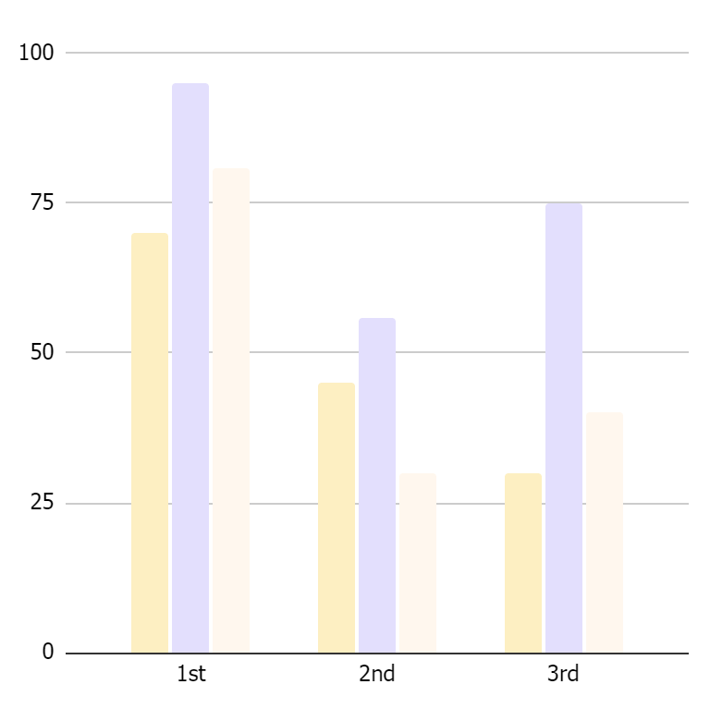
Features in percentages
65%
Saturn
Saturn is one of the gas giants with rings
25%
Jupiter
Jupiter is the biggest planet of the Solar System
10%
Mars
Despite being red, Mars is actually a very cold place
Follow the link in the graph to modify its data and then paste the new one here. For more info, click here

Slide 18
KWL brainstorming
 | What I know | What I want to know | What I learned
01 | Venus has a very beautiful name | Jupiter is the biggest planet in the Solar System | Saturn was named after a Roman god
02 | Venus is the second planet from the Sun | Jupiter is the fourth-brightest object in the night sky | Saturn is a gas giant and has several rings
03 | Venus has extremely high temperatures | Jupiter was named after the Roman god of the skies | Saturn has a high number of moons

Slide 19
Learning situations
1st
Mars is actually a very cold place
2nd
Saturn is a gas giant with several rings
Venus has extremely high temperatures
4th
Mercury is a very small planet
3rd

Slide 20
Sequence
Mars
Venus
Mars is full of iron oxide dust
Venus is the second planet from the Sun
Neptune
Jupiter
It’s the farthest planet from the Sun
Jupiter is the biggest planet of them all
Mercury
Saturn
It’s the closest planet to the Sun
Saturn is a gas giant and has several rings

Slide 21
Cause and effect
Goal
Environment
Materials
Mercury is the closest planet to the Sun
Venus is the second planet from the Sun
People
Methods
Mars is actually a extremely cold place
Jupiter is the biggest planet of them all
Metering
Machines
Saturn is a gas giant and has several rings
Neptune is far away from us

Slide 22
Question and answer
Question
Is Mercury the closest planet to the Sun and the smallest one in the Solar System? Note that it’s a bit larger than the Moon
Answer
Venus has a beautiful name and is the second planet from the Sun. It’s hot and has a poisonous atmosphere

Slide 23
1,500,000
Big numbers catch your audience’s attention

Slide 24
Timeline
1st
2nd
3rd
4th
Venus
Neptune
Saturn
Jupiter
Venus is a very hot planet
Neptune is far away from us
Saturn is a
ringed planet
Jupiter is the biggest planet

Slide 25
Parts and whole
The whole object
Missed parts
Mercury is the closest planet to the Sun and the smallest one in the entire Solar System
Earth is the third planet from the Sun and the only one that harbors life in the System
Object 1
Function
Object 2
Venus has a beautiful name and is the second planet from the Sun. It’s terribly hot
Object 3

Slide 26
Learning situation example
Basic knowledge
Real life connection
You can write here…
You can write here…
Justification
Final product
You can write here…
You can write here…

Slide 27
Learning situation example
Evaluation criteria
You can write here the evaluation criteria…

Slide 28
Learning situation example
Operational descriptors
Specific competencies
You can write here…
You can write here…
Key competencies
You can write here…

Slide 29
Learning situation example
Resources
ICT Tools
Project fundamentals
You can write here…
You can write here…
You can write here…

Slide 30
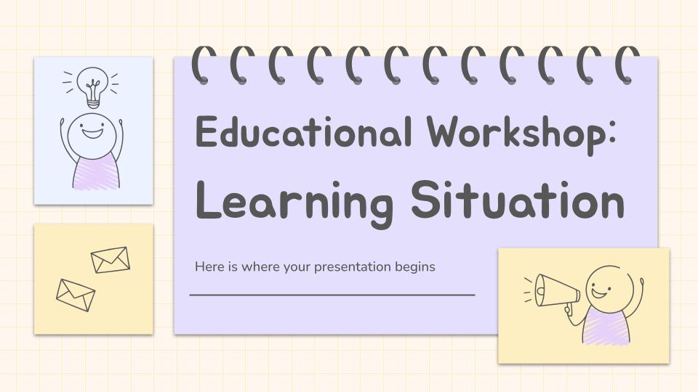
Computer mockup
You can replace the image on the screen with your own work. Just right-click on it and select “Replace image”

Slide 31
Thanks
Do you have any questions?
youremail@freepik.com
+91 620 421 838
yourwebsite.com
Please keep this slide for attribution

